Slide 1
Proxy Recitation
Jeffrey Liu
Recitation 13: November 23, 2015

Slide 2
Outline
Getting content on the web: Telnet/cURL Demo
How the web really works
Networking Basics
Proxy
Due Tuesday, December 8th
Grace days allowed
String Manipulation in C

Slide 3
The Web in a Textbook
Client request page, server provides, transaction done.
A sequential server can handle this. We just need to serve one page at a time.
This works great for simple text pages with embedded styles.
Web
client
(browser)
Web
server

Slide 4
Telnet/Curl Demo
Telnet
Interactive remote shell – like ssh without security
Must build HTTP request manually
This can be useful if you want to test response to malformed headers
[rjaganna@makoshark ~]% telnet www.cmu.edu 80
Trying 128.2.42.52...
Connected to WWW-CMU-PROD-VIP.ANDREW.cmu.edu (128.2.42.52).
Escape character is '^]'.
GET http://www.cmu.edu/ HTTP/1.0
HTTP/1.1 301 Moved Permanently
Date: Sat, 11 Apr 2015 06:54:39 GMT
Server: Apache/1.3.42 (Unix) mod_gzip/1.3.26.1a mod_pubcookie/3.3.4a mod_ssl/2.8.31 OpenSSL/0.9.8e- fips-rhel5
Location: http://www.cmu.edu/index.shtml
Connection: close
Content-Type: text/html; charset=iso-8859-1
<!DOCTYPE HTML PUBLIC "-//IETF//DTD HTML 2.0//EN">
<HTML><HEAD>
<TITLE>301 Moved Permanently</TITLE>
</HEAD><BODY>
<H1>Moved Permanently</H1>
The document has moved <A HREF="http://www.cmu.edu/index.shtml">here</A>.<P>
<HR>
<ADDRESS>Apache/1.3.42 Server at <A HREF="mailto:webmaster@andrew.cmu.edu">www.cmu.edu</A> Port 80</ADDRESS>
</BODY></HTML>
Connection closed by foreign host.

Slide 5
Telnet/cURL Demo
cURL
“URL transfer library” with a command line program
Builds valid HTTP requests for you!
Can also be used to generate HTTP proxy requests:
[rjaganna@makoshark ~]% curl http://www.cmu.edu/
<!DOCTYPE HTML PUBLIC "-//IETF//DTD HTML 2.0//EN">
<HTML><HEAD>
<TITLE>301 Moved Permanently</TITLE>
</HEAD><BODY>
<H1>Moved Permanently</H1>
The document has moved <A HREF="http://www.cmu.edu/index.shtml">here</A>.<P>
<HR>
<ADDRESS>Apache/1.3.42 Server at <A HREF="mailto:webmaster@andrew.cmu.edu">www.cmu.edu</A> Port 80</ADDRESS>
</BODY></HTML>
[rjaganna@makoshark ~]% curl --proxy lemonshark.ics.cs.cmu.edu:3092 http://www.cmu.edu/
<!DOCTYPE HTML PUBLIC "-//IETF//DTD HTML 2.0//EN">
<HTML><HEAD>
<TITLE>301 Moved Permanently</TITLE>
</HEAD><BODY>
<H1>Moved Permanently</H1>
The document has moved <A HREF="http://www.cmu.edu/index.shtml">here</A>.<P>
<HR>
<ADDRESS>Apache/1.3.42 Server at <A HREF="mailto:webmaster@andrew.cmu.edu">www.cmu.edu</A> Port 80</ADDRESS>
</BODY></HTML>

Slide 6
How the Web Really Works
In reality, a single HTML page today may depend on 10s or 100s of support files (images, stylesheets, scripts, etc.)
Builds a good argument for concurrent servers
Just to load a single modern webpage, the client would have to wait for 10s of back-to-back request
I/O is likely slower than processing, so back
Caching is simpler if done in pieces rather than whole page
If only part of the page changes, no need to fetch old parts again
Each object (image, stylesheet, script) already has a unique URL that can be used as a key

Slide 7
How the Web Really Works
Excerpt from www.cmu.edu/index.html:
<html lang="en" xml:lang="en" xmlns="http://www.w3.org/1999/xhtml">
<head>
...
<link href="homecss/cmu.css" rel="stylesheet" type="text/css"/>
<link href="homecss/cmu-new.css" rel="stylesheet" type="text/css"/>
<link href="homecss/cmu-new-print.css" media="print" rel="stylesheet" type="text/css"/>
<link href="http://www.cmu.edu/RSS/stories.rss" rel="alternate" title="Carnegie Mellon Homepage Stories" type="application/rss+xml"/>
...
<script language="JavaScript" src="js/dojo.js" type="text/javascript"></script>
<script language="JavaScript" src="js/scripts.js" type="text/javascript"></script>
<script language="javascript" src="js/jquery.js" type="text/javascript"></script>
<script language="javascript" src="js/homepage.js" type="text/javascript"></script>
<script language="javascript" src="js/app_ad.js" type="text/javascript"></script>
...
<title>Carnegie Mellon University | CMU</title>
</head>
<body> ...

Slide 8
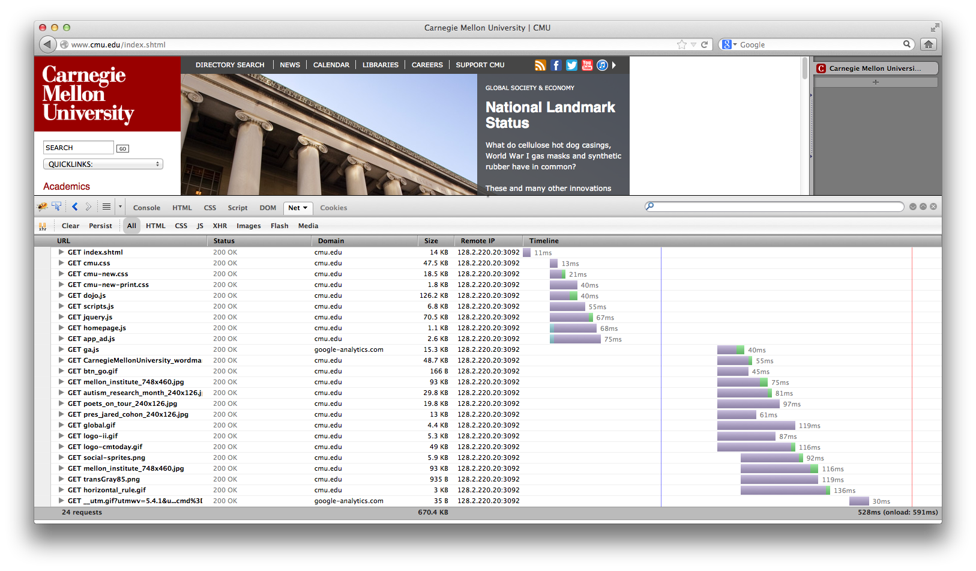
Sequential Proxy

Slide 9
Sequential Proxy
Note the sloped shape of when requests finish
Although many requests are made at once, the proxy does not accept a new job until it finishes the current one
Requests are made in batches. This results from how HTML is structured as files that reference other files.
Compared to the concurrent example (next), this page takes a long time to load with just static content

Slide 10
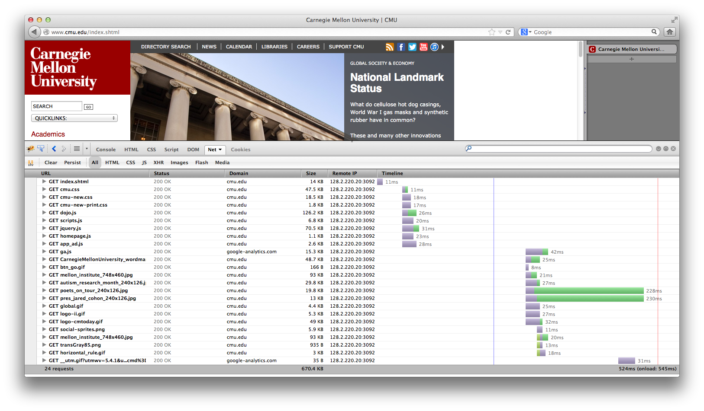
Concurrent Proxy

Slide 11
Concurrent Proxy
Now, we see much less purple (waiting), and less time spent overall.
Notice how multiple green (receiving) blocks overlap in time
Our proxy has multiple connections open to the browser to handle several tasks at once

Slide 12
How the Web Really Works
A note on AJAX (and XMLHttpRequests)
Normally, a browser will make the initial page request then request any supporting files
And XMLHttpRequest is simply a request from the page once it has been loaded & the scripts are running
The distinction does not matter on the server side – everything is an HTTP Request

Slide 13
Outline
Getting content on the web: Telnet/cURL Demo
How the web really works
Networking Basics
Proxy
Due Tuesday, December 8th
Grace days allowed
String Manipulation in C

Slide 14
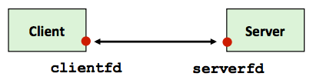
Sockets
Carnegie Mellon
What is a socket?
To an application, a socket is a file descriptor that lets the application read/write from/to the network
(all Unix I/O devices, including networks, are modeled as files)
Clients and servers communicate with each other by reading from and writing to socket descriptors
The main difference between regular file I/O and socket I/O is how the application “opens” the socket descriptors

Slide 15
Overview of the Sockets Interface
Carnegie Mellon
Client
Server
getaddrinfo
getaddrinfo
socket
socket
open_listenfd
open_clientfd
bind
listen
Connection
request
connect
accept
Client / Server
Session
rio_writen
rio_readlineb
Await connection
request from
next client
rio_readlineb
rio_writen
close
EOF
rio_readlineb
close

Slide 16
Host and Service Conversion: getaddrinfo
getaddrinfo is the modern way to convert string representations of host, ports, and service names to socket address structures.
Replaces obsolete gethostbyname - unsafe because it returns a pointer to a static variable
Advantages:
Reentrant (can be safely used by threaded programs).
Allows us to write portable protocol-independent code(IPv4 and IPv6)
Given host and service, getaddrinfo returns result that points to a linked list of addrinfo structs, each pointing to socket address struct, which contains arguments for sockets APIs.
getnameinfo is the inverse of getaddrinfo, converting a socket address to the corresponding host and service.

Slide 17
Sockets API
Carnegie Mellon
int socket(int domain, int type, int protocol);
Create a file descriptor for network communication
used by both clients and servers
int sock_fd = socket(PF_INET, SOCK_STREAM, IPPROTO_TCP);
One socket can be used for two-way communication
int bind(int socket, const struct sockaddr *address, socklen_t address_len);
Associate a socket with an IP address and port number
used by servers
struct sockaddr_in sockaddr – family, address, port

Slide 18
Sockets API
Carnegie Mellon
int listen(int socket, int backlog);
socket: socket to listen on
used by servers
backlog: maximum number of waiting connections
err = listen(sock_fd, MAX_WAITING_CONNECTIONS);
int accept(int socket, struct sockaddr *address, socklen_t *address_len);
used by servers
socket: socket to listen on
address: pointer to sockaddr struct to hold client information after accept returns
return: file descriptor

Slide 19
Sockets API
Carnegie Mellon
int connect(int socket, struct sockaddr *address, socklen_t address_len);
attempt to connect to the specified IP address and port described in address
used by clients
int close(int fd);
used by both clients and servers
(also used for file I/O)
fd: socket fd to close

Slide 20
Sockets API
Carnegie Mellon
ssize_t read(int fd, void *buf, size_t nbyte);
used by both clients and servers
(also used for file I/O)
fd: (socket) fd to read from
buf: buffer to read into
nbytes: buf length
ssize_t write(int fd, void *buf, size_t nbyte);
used by both clients and servers
(also used for file I/O)
fd: (socket) fd to write to
buf: buffer to write
nbytes: buf length

Slide 21
Outline
Getting content on the web: Telnet/cURL Demo
How the web really works
Networking Basics
Proxy
Due Tuesday, December 8th
Grace days allowed
String Manipulation in C

Slide 22
Byte Ordering Reminder
So, how are the bytes within a multi-byte word ordered in memory?
Conventions
Big Endian: Sun, PPC Mac, Internet
Least significant byte has highest address
Little Endian: x86, ARM processors running Android, iOS, and Windows
Least significant byte has lowest address

Slide 23
Byte Ordering Reminder
So, how are the bytes within a multi-byte word ordered in memory?
Conventions
Big Endian: Sun, PPC Mac, Internet
Least significant byte has highest address
Make sure to use correct endianness

Slide 24
Proxy - Functionality
Should work on vast majority of sites
Twitch, CNN, NY Times, etc.
Some features of sites which require the POST operation (sending data to the website), will not work
Logging in to websites, sending Facebook message
HTTPS is not expected to work
Google, YouTube (and some other popular websites) now try to push users to HTTPs by default; watch out for that
Cache previous requests
Use LRU eviction policy
Must allow for concurrent reads while maintaining consistency
Details in write up

Slide 25
Proxy - Functionality
Why a multi-threaded cache?
Sequential cache would bottleneck parallel proxy
Multiple threads can read cached content safely
Search cache for the right data and return it
Two threads can read from the same cache block
But what about writing content?
Overwrite block while another thread reading?
Two threads writing to same cache block?

Slide 26
Proxy - How
Proxies are a bit special - they are a server and a client at the same time.
They take a request from one computer (acting as the server), and make it on their behalf (as the client).
Ultimately, the control flow of your program will look like a server, but will have to act as a client to complete the request
Start small
Grab yourself a copy of the echo server (pg. 946) and client (pg. 947) in the book
Also review the tiny.c basic web server code to see how to deal with HTTP headers
Note that tiny.c ignores these; you may not

Slide 27
Proxy - How
What you end up with will resemble:
Client socket address
128.2.194.242:51213
Server socket address
208.216.181.15:80
Client
Proxy
Server
(port 80)
Proxy server socket address
128.2.194.34:15213
Proxy client socket address
128.2.194.34:52943

Slide 28
Summary
Step 1: Sequential Proxy
Works great for simple text pages with embedded styles
Step 2: Concurrent Proxy
multi-threading
Step 3 : Cache Web Objects
Cache individual objects, not the whole page
Use an LRU eviction policy
Your caching system must allow for concurrent reads while maintaining consistency. Concurrency? Shared Resource?

Slide 29
Proxy – Testing & Grading
New: Autograder
./driver.sh will run the same tests as autolab:
Ability to pull basic web pages from a server
Handle a (concurrent) request while another request is still pending
Fetch a web page again from your cache after the server has been stopped
This should help answer the question “is this what my proxy is supposed to do?”
Please don’t use this grader to definitively test your proxy; there are many things not tested here

Slide 30
Proxy – Testing & Grading
Test your proxy liberally
The web is full of special cases that want to break your proxy
Generate a port for yourself with ./port-for-user.pl [andrewid]
Generate more ports for web servers and such with ./free-port.sh
Consider using your andrew web space (~/www) to host test files
You have to visit https://www.andrew.cmu.edu/server/publish.html to publish your folder to the public server
Create a handin file with make handin
Will create a tar file for you with the contents of your proxylab-handin folder

Slide 31
Outline
Getting content on the web: Telnet/cURL Demo
How the web really works
Networking Basics
Proxy
Due Tuesday, December 8th
Grace days allowed
String Manipulation in C

Slide 32
String manipulation in C
sscanf: Read input in specific format
int sscanf(const char *str, const char *format, …);
Example:
buf = “213 is awesome”
// Read integer and string separated by white space from buffer ‘buf’
// into passed variables
ret = sscanf(buf, “%d %s %s”, &course, str1, str2);
This results in:
course = 213, str1 = is, str2 = awesome, ret = 3

Slide 33
String manipulation (cont)
sprintf: Write input into buffer in specific format
int sprintf(char *str, const char *format, …);
Example:
buf[100];
str = “213 is awesome”
// Build the string in double quotes (“”) using the passed arguments
// and write to buffer ‘buf’
sprintf(buf, “String (%s) is of length %d”, str, strlen(str));
This results in:
buf = String (213 is awesome) is of length 14

Slide 34
String manipulation (cont)
Other useful string manipulation functions:
strcmp, strncmp, strncasecmp
strstr
strlen
strcpy, strncpy

Slide 35
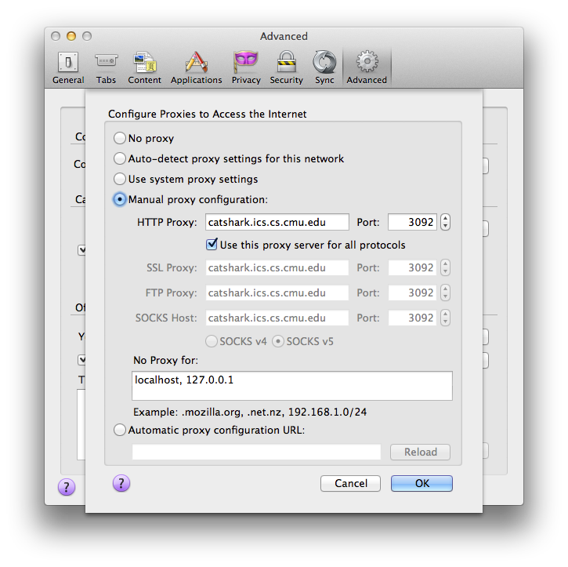
Aside: Setting up Firefox to use a proxy
You may use any browser, but we’ll be grading with Firefox
Preferences > Advanced > Network > Settings… (under Connection)
Check “Use this proxy for all protocols” or your proxy will appear to work for HTTPS traffic.

Slide 36
Acknowledgements
Slides derived from recitation slides of last 2 years by
Shiva
Hartaj Singh Dugal
Ian Hartwig
Rohith Jagannathan

Slide 37
Questions?

